Slide 1


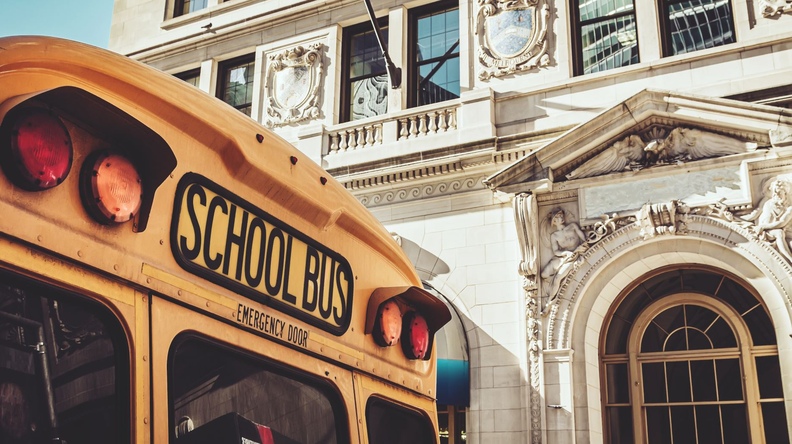

Lesson 4 what time is the next bus?
English 1

Slide 2
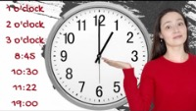
HOW TO TALK ABOUT THE TIME IN ENGLISH

Slide 3
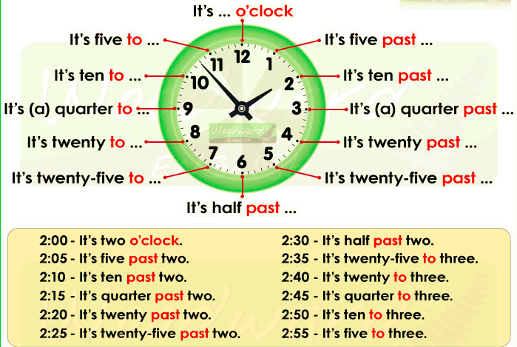
What time is it?

Slide 4

Task 1 Watch the video

Slide 5
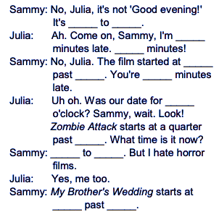
Task 2 Watch the first scene again (0.00–1.30). Write the numbers (not words) to complete the conversation.

Slide 6
Task 3 Match the sentences with the times.
A. It's a quarter past three.
B. It's a quarter to three.
C. It's five past ten.
D. It's twenty-five past four.
E. It's half past eight.
F. It's six o'clock.
G. It's ten to eleven.
H. It's twenty to twelve.
1. 6.00 _____
2. 8.30 _____
3. 3.15 _____
4. 2.45 _____
5. 10.05 _____
6. 10.50 _____
7. 11.40 _____
8. 4.25 _____

Slide 7
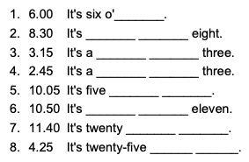
Task 4 Complete the times with the correct words.

Slide 8
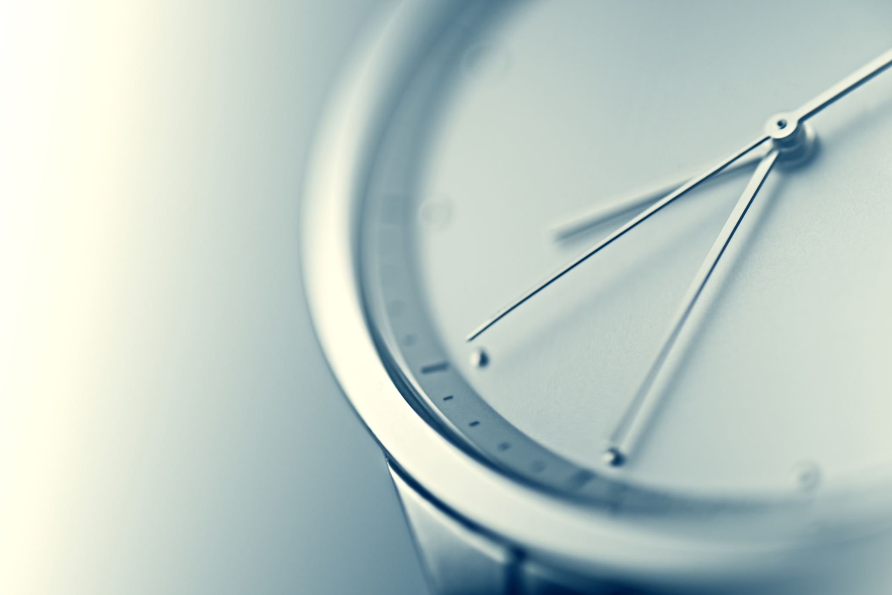
Task 5 Put the words in the correct order.
is / time / it/ What /? _____________________________
is / time / What / the /? _____________________________
m / I / late / minutes / ten /. _____________________________
does / start / the / film / time / What /? _______________________
5. at / five / half / It / past / starts /. ____________________________
6. a / coffee / for / got / time / We've /. _________________________
7. got / minutes / twenty / We've /. ____________________________

Slide 9

Task 6 Can you remember the expressions from Task 5? Complete them with the correct words.
What time______________?
What is______________?
I_______ten minutes_______.
What_______does the film _______?
It starts_______half_______five.
We've got______________a coffee.
We've_______twenty________.

Slide 10
Task 7 Put the words in order to make sentences.
Now / is / What / time / it /? ______________________________
please /, / the / What / is / time /? ______________________________
hours / You / two / late / are / ! ______________________________
meeting / time / does / the / start / What / ? ______________________________
quarter / It / ten / at / a / to / starts /. ______________________________
We’ve / sandwich / time / got / for/ a / sandwich.__________________________
Half / got / hour / an / We've /. ___________________________

Slide 11
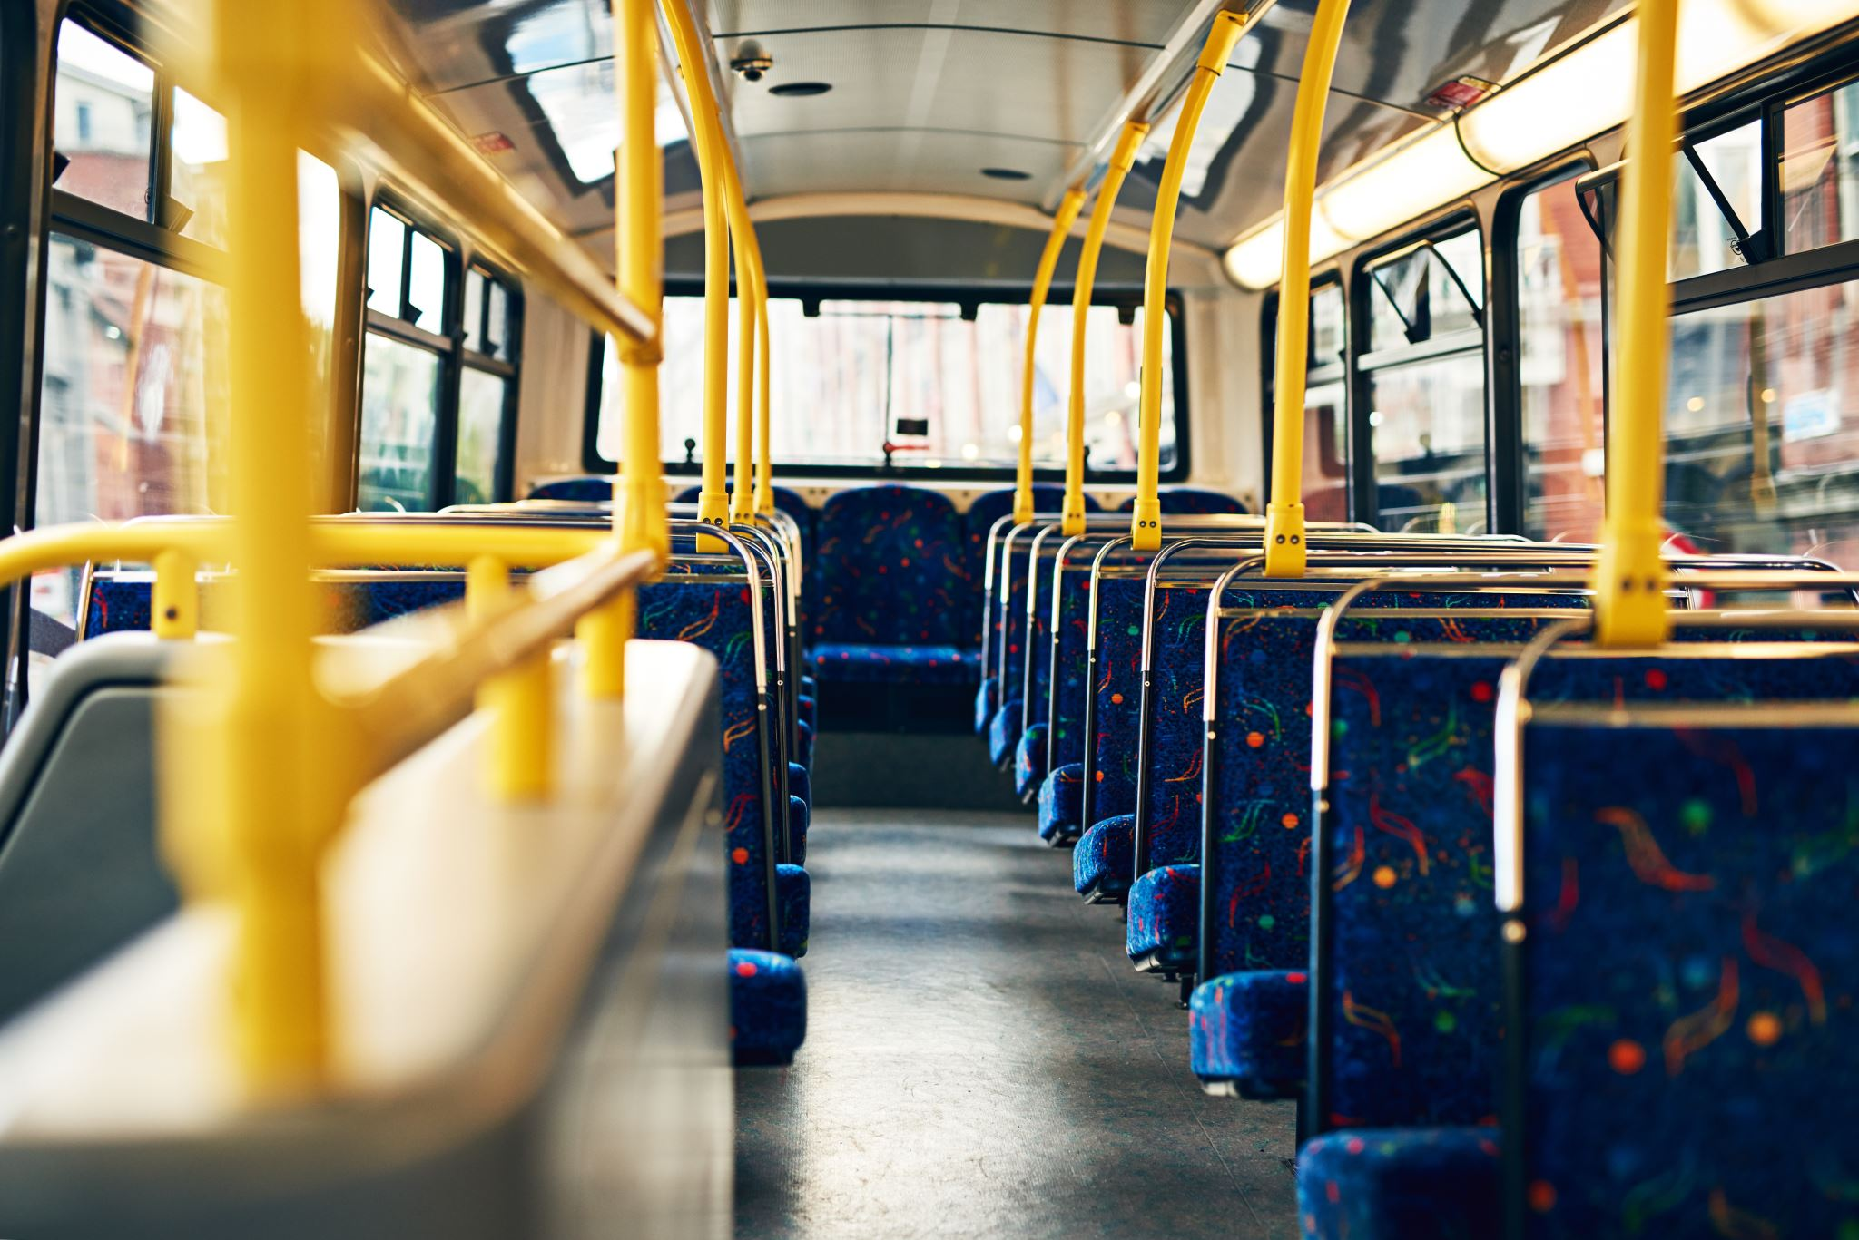
Means of transportation and prices – speaking
What are some means of transportation you know?
What public transportation is common in Pelotas?
What transportation is common to you? Which means of transportation do you use?
- How much is the bus ticket in your city?

Slide 12
Means of transportation - speaking
Which transportation is not common in your city?
What is the transport used to travel short distances in Brazil? What about long distances?
Which means of transportion is free?

Slide 13
Means of transportation - speaking
-How do you go...
...to school?
...home after school?
...to the bakery, drugstore or grocery store in your neighborhood?
...to your friend’s house?

Slide 14
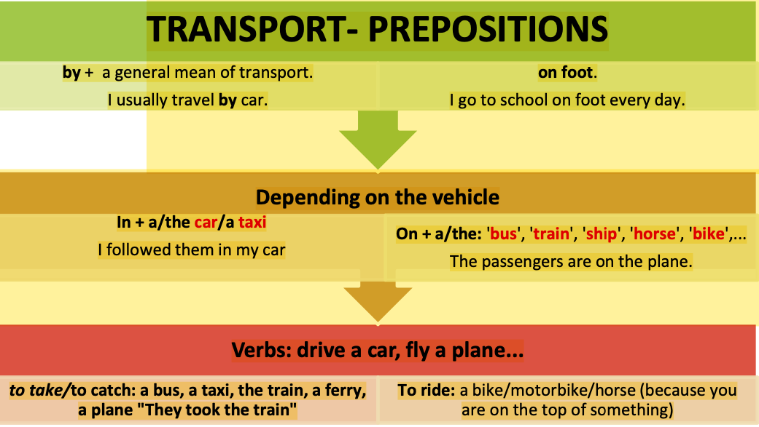
Means of transportation - prepositions

Slide 15
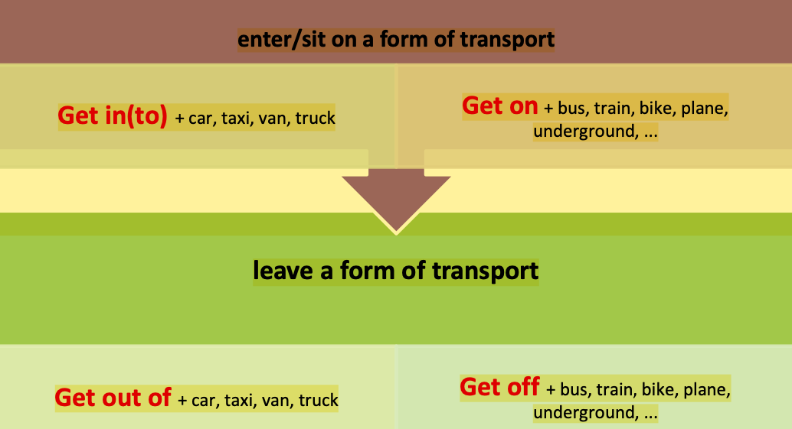
Means of transportation - prepositions

Slide 16
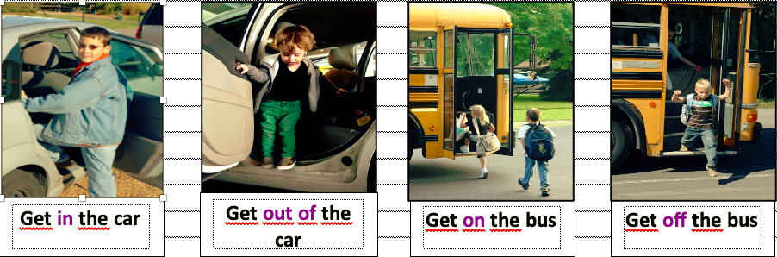
Means of transportation - prepositions
With small and private means of transportion
With big and public means of transportation

Slide 17
We travel by / IN / ON + means of transportation
Using the preposition By
When we talk about general ways to travel we always use the preposition ‘by’. For example – We travel by car ,by train , by can, by bus, by plane and so on.
We can also use the preposition ‘by’ to refer to the transportation environment or the surface for example, by air, by land, by sea, by rail.
*BUT: When we Walk somewhere we usually say to go ON FOOT.
Using the preposition In
When we talk about specific transport vehicles we use the preposition ‘in’. If you can sit inside the vehicle we use ‘in’. For example – In a car , In a truck , in a helicopter , in a taxi, in a rowboat.
Using the preposition on
When we talk about specific transport vehicles especially on which one can stand or walk on a vehicle, we use the preposition ‘on’. For example – We go on a plane , we go on a ferry , we go on a ship , on a Train , on a Bicycle, on a Motorbike , ( and the basic mode of travel – on foot).

Slide 18
Means of transportation and prepositions
How can you say this in ENGLISH?
Tu estás no ônibus agora?
Nós estamos no avião.
Sua irmã está no táxi?
Eu vou para o IFSUL à pé.
Eu ando de bicicleta no domingo das 9 às 10:00.
Saia do carro, por favor.
Eu sempre saio do ônibus na frente da escola.
Ele entrou no ônibus às 7:30 da manhã.
Meus filhos entram no carro às 6:15 da manhã em ponto para ir para a escola.
Eu pego o ônibus para Arroio Grande às 23:05.

Slide 19
Talking about prices
Antes de pegar um meio de transporte pago, normalmente tentamos descobrir o valor da passagem e as formas de pagamento. Para isso, podemos utilizar a mesma pergunta que usamos para saber o preço de qualquer coisa - a estrutura How much.
Rosa: How much is the bus ticket?
Driver: It’s $2.25 in cash.
Rosa: Here you are.
Ao responder uma pergunta com How much..? , os números podem ser ditos de diferentes formas. Acompanhe como ficaria para o valor de $2,50:
It’s two fifty. (short way)
It’s two dollars and fifty cents. (long way)
Two fifty. (short way)

Slide 20
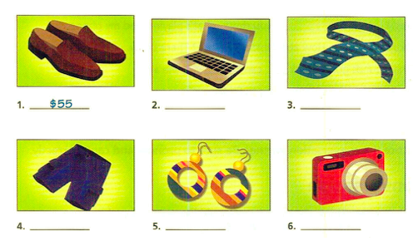
Task 1: People are asking about prices. Listen and write the price of each item. (LISTENING ACTIVITY IN CLASS)

Slide 21
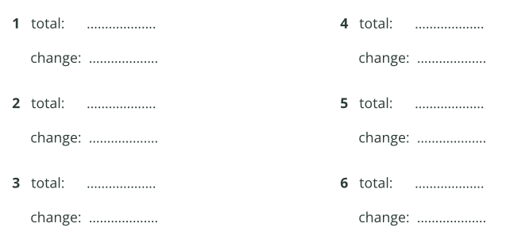
Task 2: Listen to cashiers in a store. Write the total amount each person needs to pay and the amount of change each person receives. (Listening activity in class)

